Slide 1
Getting to 70% Cardiac Rehabilitation Participation: Action Steps for Clinicians, Hospitals, and Health Systems
Presenter’s Name
Title
Organization’s Name
Event Title
Date

Slide 2
Heart Disease and Stroke Burden
Cardiovascular disease(CVD) remains the leading cause of death in the US, accounting for 1 in every 4 deaths.
CVD is the greatest contributor to racial disparities in life expectancy.
About 1 in every 9 health care dollars is spent on cardiovascular disease.
National Center for Health Statistics. Accessed January 13 and February 21, 2022. https://wonder.cdc.gov/mcd-icd10.html
Purnell TS, et al. Health Aff (Millwood). 2016;35(8):1410-5.
Agency for Healthcare Research and Quality. Medical Expenditure Panel Survey (MEPS). Accessed April 8, 2021. https://meps.ahrq.gov/mepsweb/data_stats/MEPS_topics.jsp?topicid=32Z-1
Notes:
Cardiovascular disease remains the leading cause of death in the United States accounting for 1 in every 4 deaths.
Cardiovascular disease is the greatest contributor to racial disparities in life expectancy.
And, on average, about 1 in 9 health care dollars is spent on combatting cardiovascular disease.

Slide 3
Cardiovascular Disease Mortality 1999-2018
heart failure
CVD = cardiovascular disease
CHD = coronary heart disease
Goff DC, et al. Circulation. 2021;143(8):837-851.
Notes:
From the 70s through to 2011, the mortality rates for cardiovascular disease, coronary heart disease, and stroke has been on the decline.
In recent times, we have seen a deceleration of this rate of decline and even an acceleration in the rate of CVD mortality in some subpopulations, which could indicate a reversing trend, likely due to increases in obesity and diabetes.
In fact, we now see a rise in mortality attributed to heart failure, a condition that is affecting more younger adults.
The flattening of the decline is worrying and warrants attention on strategies to reverse this troubling trend.
CVD = cardiovascular disease, CHD = coronary heart disease (mostly heart attacks)

Slide 4
Alarming Mortality Rate Changes Among Adults Aged 35–64 Health and Healthcare Crisis
Percent change in heart disease rate, 2010–2017 (% of counties)
Ritchey MD, et al. Trends Cardiovasc Med. 2020 Aug;30(6):364-374.
Notes:
CVD is often seen as a disease of the elderly but when we look at changes in heart disease death rate among people ages 35-64, the trend is alarming.
On this map, the red counties indicate places where the heart disease death rate is increasing in this younger group.
In total, nearly 70% of counties in the U.S. are seeing a rise in heart disease mortality rates among people ages 35-64.

Slide 5
Million Hearts® 2027 Aim: Prevent 1 Million Heart Attacks and Strokes in 5 Years
Co-led by the Centers for Disease Control and Prevention (CDC) and the Centers for Medicare & Medicaid Services (CMS)
Works with and through public and private partners at the local, state, and federal level to:
Convene champions
Facilitate impactful collaboration
Implement evidence-based strategies
Engage to address health inequity
Notes:
To address this larger burden of disease and improve related risk factors, Million Hearts was launched.
Million Hearts® is a national initiative that aims to prevent 1 million heart attacks, strokes, and other cardiovascular events* over the next 5 years.
This national initiative is co-led by the Centers for Disease Control and Prevention and the Centers for Medicare and Medicaid Services and is carried out by a variety of public and private partners at local, state, and federal levels.
Million Hearts® provides a platform to shine light on a selection of evidence-based strategies for cardiovascular disease prevention, and the initiative serves as a learning lab and repository of tools, protocols, and resources for partners to use to implement these strategies.
Specifically, the initiative:
Convenes health care and public health champions;
Facilitates impactful collaboration and resource sharing;
Promotes implementation of evidence-based strategies; and
Engages partners to enact specific policies, processes, and practices to address health inequity

Slide 6
Million Hearts® 2027 Priorities
Building Healthy Communities
Decrease Tobacco Use
Decrease Physical Inactivity
Decrease Particle Pollution Exposure
Optimizing Care
Improve Appropriate Aspirin or Anticoagulant Use
Improve Blood Pressure Control
Improve Cholesterol Management
Improve Smoking Cessation
Increase Use of Cardiac Rehabilitation
70%
Focusing On Health Equity
Pregnant and Postpartum Women with Hypertension
People from Racial/Ethnic Minority Groups
People with Behavioral Health Issues Who Use Tobacco
People Who Live in Rural Areas or Other ‘Access Deserts’
People with Lower Incomes
Notes:
The work of Million Hearts is organized into three priority areas:
Building Healthy Communities to make changes to the environments in which people live, learn, work, and play, so that the healthy choices are the easier choices for people to make.
Optimizing Care so that those with and at risk for cardiovascular disease receive the services and acquire the skills needed to reduce the likelihood of having a heart attack or stroke; and
Focusing on Health Equity for populations who suffer worse outcomes of cardiovascular disease and where there is evidence and the opportunity to make a significant impact.
This slide summarizes the goals and priority populations within this three-pronged framework.
[Click for animation]
Today, I will be speaking to the Million Hearts contributions to increase use of cardiac rehabilitation for which we have set a target of helping at least…
[Click for animation]
…70% of eligible patients participate in at least 1 session of cardiac rehabilitation by 2027.
I will also touch on how this work relates to improving cardiovascular health outcomes for people from racial and ethnic minority groups, people with lower incomes, and people who live in rural areas or other access deserts.

Slide 7
What is Cardiac Rehabilitation?
Notes:
Let’s start with an overview about cardiac rehabilitation – What is it? How is it delivered? What are its benefits?

Slide 8
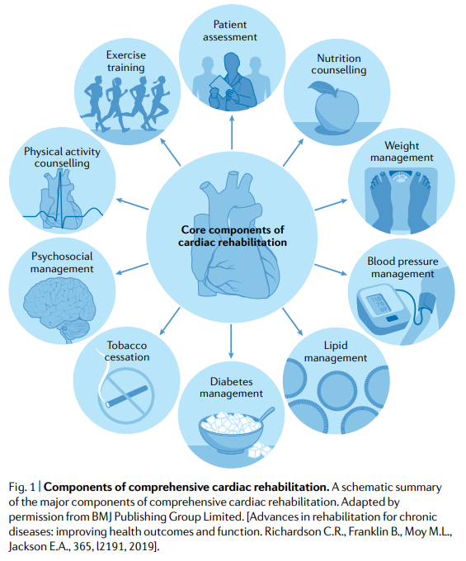
Description of Cardiac Rehabilitation (CR)
Comprehensive, medically-supervised, secondary cardiovascular disease prevention program
Typically administered in 36 X 31+ minute-long sessions over ~12 weeks to:
Limit the effects of cardiac illness
Reduce the risk for death or secondary cardiovascular events
Prevent rehospitalization
Control cardiac symptoms
Stabilize or reverse the atherosclerotic process
Improve health, quality of life, and vocational status of patients
Balady GJ, et al. Circulation. 2007;115:2675-2682.
Taylor RS, et al. Nat Rev Cardiol. 2022;19:180-194.
Notes:
Cardiac rehabilitation is a medically supervised secondary cardiovascular disease prevention program for eligible cardiac patients to improve the patient’s health and extend their lives.
The package of services typically includes:
Physician-prescribed and personalized exercise,
Cardiac risk factor modification services that include education, dietary counseling, and behavioral interventions (as needed)
A psychosocial assessment,
Outcomes assessment, and
An individualized treatment plan that is approved by a physician every 30 days
A full dose of cardiac rehabilitation includes 36 sessions that last over 31 minutes. These sessions are generally completed over 12 weeks or 3 months.
There is a strong dose response between the number of sessions and the health outcomes of cardiac rehabilitation. Therefore, attendance in more sessions will produce greater benefits in the participant’s overall health.
The program Cardiac rehab is designed to:
Reduce the physical, mental, and emotional effects of a cardiac event
Lower the risk for another heart attack or death
Control cardiac symptoms and/or reverse the atherosclerotic process, and
Improve the overall wellbeing of the patient so they can get back to their regular activities.

Slide 9
How is CR delivered?
Typically delivered in an outpatient hospital setting
Staffed by a multidisciplinary team of professionals that may include:
supervising clinicians
exercise physiologists and/or nurses
pharmacists,
nutritionists/dieticians, and
psychosocial counselors
Facilitates peer-to-peer sharing and social support
Notes:
Cardiac rehabilitation is typically delivered in the hospital outpatient setting, but new virtual and hybrid models allow patients to participate in other locations.
While staffing models vary, the multidisciplinary cardiac rehabilitation team generally includes some combination of exercise physiologists, registered nurses, pharmacists, registered dieticians, psychosocial counselors and other clinical staff.
Cardiac rehabilitation is typically provided to a group of cardiac patients, giving participants a peer-support system to help them through their rehabilitation.

Slide 10
What are the benefits of CR?
May reduce:
Death from all causes by 13%
All-cause Hospitalizations by 42% and HF-specific hospitalizations by 41%
Risk of heart attacks by 28%
Time to return to work
Improves health-related quality of life scores
More is Better (Dose Response)
36 vs fewer sessions reduces risk of heart attack and death
25 sessions is generally considered a healthy “dose”
Dibben G, et al. Cochrane Database Syst Rev. 2021;11:CD001800.
Long L, et al. Cochrane Database Syst Rev. 2019;1:CD003331.
Hegewald J, et al. Cochrane Database Syst Rev. 2019;3:CD010748.
Hammill BG, et al. Circulation. 2010;121:63–70.
Suaya, JA, et al. J Am Coll Cardiol. 2009;54(1):25-33.
Notes:
Strong evidence shows cardiac rehabilitation reduces death from all causes by 13 to 24 percent and from cardiovascular causes by 26 to 31 percent.
Cardiac rehabilitation is also proven to keep people out of the hospital by reducing hospitalizations by 42%. And the risk for having a heart attack after receiving cardiac rehabilitation is reduced by 28%.
The team-based care you receive at cardiac rehabilitation also improves the functional status, mood, and quality of life scores for participants.
And, again, there is a strong dose-response in cardiac rehabilitation. The benefits are greatest if the participant completes all 36 sessions, although many of these benefits have been seen in people participating in 25 sessions or more.

Slide 11
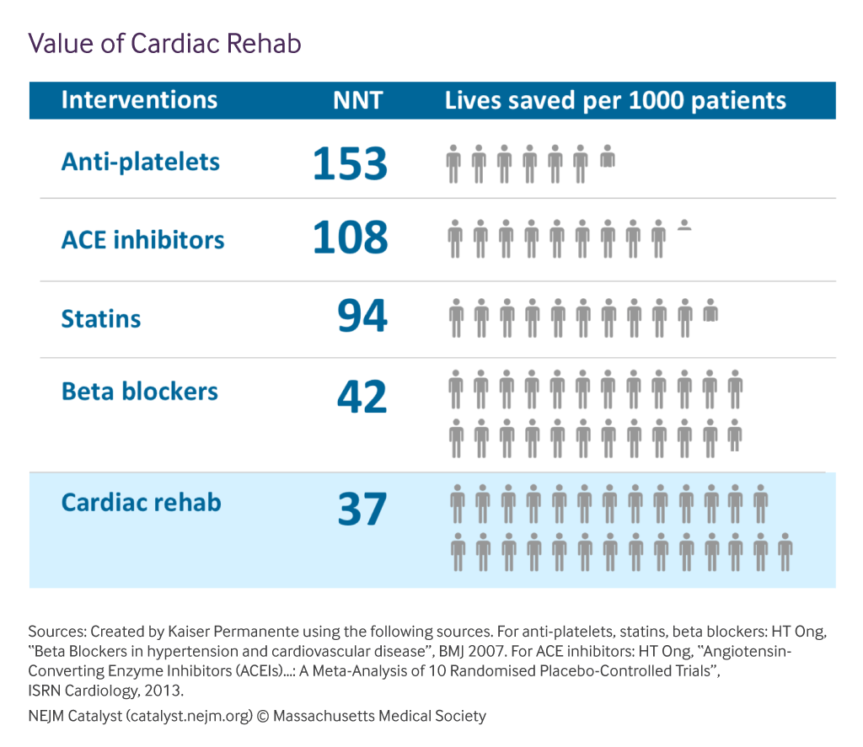
CR Saves Lives
Funahashi T., et al. NEJM Catalyst. 2019;5(4).
NNT = Number needed to treat (to prevent 1 death)
Notes:
Ultimately, cardiac rehabilitation saves lives.
Only 37 eligible patients need to receive cardiac rehabilitation to prevent 1 death. This number needed to treat or NNT is fewer than other cardiovascular disease preventive intervention and equates to saving the lives of 27 individuals for every 1000 people served.
CR, however, is an intervention recommended for a specific set of cardiac patients.

Slide 12
CR Recommendations in Clinical Practice Guidelines (with the highest level of strength and quality of evidence)
Patient Population | Recommendation Level
Patients with acute coronary syndromes | Class 1A for CR
Patients who have had a myocardial infarction | Class 1A for CR
Patients who have undergone coronary artery revascularization surgery | Class 1A for CR
Patients with stage C heart failure | Class 1A for exercise training Class 2A for CR
Patients with peripheral artery disease | Class 1A for supervised exercise training
Amsterdam EA, et al. J Am Coll Cardiol. 2014;64(24):e139‐e228.
O'Gara PT, et al. Circulation. 2013;127(4):e362‐e425.
Lawton, JS, et al. Circulation. 2022;79(2):e21–e129
Heidenreich PA, et al. Circulation. 2022;145(18):e895‐e1032.
Gerhard‐Herman MD, et al. Circulation. 2017;135(12):e686‐e725.
Notes:
Here we see that clinical practice guidelines highly recommend CR or related services for certain patient populations.
Cardiac rehabilitation is a class 1A recommendation in numerous guidelines. Class 1 recommendations have the highest level of strength and indicate that the treatment or intervention is useful and effective and should be administered for most specified patients under most circumstances. The level of evidence score of A indicates there is high-quality evidence.
Overall, cardiac rehabilitation is highly recommended in clinical practice guidelines issued by the American Heart Association, the American College of Cardiology, the Society for Cardiovascular Angiography and Interventions, and the Heart Failure Society of America.

Slide 13
Who benefits from CR?
There is strong evidence of benefit---and Medicare and commercial insurance coverage---for individuals who have:
Had a heart attack.
Stable angina.
Received a stent or angioplasty.
Heart failure
Undergone bypass, valve, or a heart, lung, or heart-lung transplant surgery.
Amsterdam EA, et al. J Am Coll Cardiol. 2014;64(24):e139‐e228.
O'Gara PT, et al. Circulation. 2013;127(4):e362‐e425.
Lawton, JS, et al. Circulation. 2022;79(2):e21–e129
Heidenreich PA, JS, et al. Circulation. 2022;145(18):e895‐e1032.
Sibilitz KL, et al. Cochrane Database Syst Rev. 2016;3:CD010876.
Rosenbaum AN, et al. Mayo Clin Proc. 2016;91(2):149-156.
Notes:
All together, there is strong evidence that cardiac rehabilitation benefits individuals who have had a heart attack, stable angina, received a stent or angioplasty, chronic heart failure, or undergone bypass, valve, or heart, lung, or heart-lung transplant.
It is a service that has been around for a long time and it is largely covered by Medicare and commercial payers for these diagnostic and procedural cardiac rehabilitation qualifiers.
In addition, individuals with peripheral arterial disease (or PAD) and intermittent claudication benefit from supervised exercise therapy or SET. Although SET for PAD is a separate and distinct service from cardiac rehabilitation, cardiac rehabilitation programs are an ideal setting for the delivery of SET.
And, again, in addition to improving clinical outcomes, cardiac rehabilitation has been shown to reduce hospitalizations and improve medication adherence, functional status, mood, and quality of life. And patients who participate in the program tend to love it.

Slide 14
How many people are using it?
Not enough.
Notes:
So, how many people are benefiting from cardiac rehabilitation?
Not nearly enough.

Slide 15
CR
https://millionhearts.hhs.gov/about-million-hearts/optimizing-care/cardiac-rehabilitation-infographic.html
Notes:
Among Medicare Fee-for-Service beneficiaries eligible for cardiac rehabilitation in 2017, enrollment, engagement and completion remained low- with 29% initiating services and only 8% completing a full dose of 36 sessions. This means approximately 70% of Medicare beneficiaries are missing the opportunity to benefit from cardiac rehabilitation.
More recent estimates suggest that participation is even lower today given disruptions caused by the COVID-19 pandemic (Varghese MS, Beatty A, Song Y, et al. Cardiac Rehabilitation and the COVID-19 Pandemic: Persistent Declines in CR Participation and Access Among US Medicare Beneficiaries. Circ Cardiovasc Qual Outcomes. 2022 Oct 31. Epub ahead of print.)
The cascade in participation from enrollment to completion is particularly concerning given the strong dose-response benefit for cardiac rehabilitation.
Finally, there are deep and persistent disparities in cardiac rehabilitation participation with women and Non-Hispanic Black people suffering from disproportionately low enrollment rates.

Slide 16
CR Use among Medicare Part B Fee-for-Service Beneficiaries by State
The overall enrollment rate
of 28.6% for all CR-eligible
Medicare beneficiaries.
Keteyian SJ, et al. J Cardiopulm Rehabil Prev. 2022;42(4):235-245.
Notes:
We also see disparities in participation based on where Medicare beneficiaries live.
Here you see the range of participation rates among Medicare beneficiaries hospitalized in 2017 with a primary qualifying event by state. The grey horizontal line indicates the average enrollment rate of 28.6% for all CR-eligible Medicare beneficiaries in the United States in 2017.
State-level enrollment rates vary substantially, with all states falling below the 70% participation rate Million Hearts goal.

Slide 17
CR Use among Medicare Part B Fee-for-Service Beneficiaries by Age, Sex, and Race/Ethnicity
*Completed 36 or more CR sessions
NH = Non-Hispanic
Keteyian SJ, et al. J Cardiopulm Rehabil Prev. 2022;42(4):235-245.
Notes:
Here are the participation rates for those who initiated CR in grey and those who completed the program in purple by age, sex, race, and ethnicity.
We see that both participation and completion of CR are lower for beneficiaries who are older than 85 years, female, and Non-Hispanic Black, Hispanic, or Asian.

Slide 18
CR Use among Medicare Part B Fee-for-Service Beneficiaries by Qualifier
= % of Medicare beneficiaries with specified qualifier who participated in ≥1 session of CR within 365 days of diagnosis or procedure
= % of Medicare beneficiaries with specified qualifier who did not participate in CR
CABG: 57% |  | Stable Angina: 3.9%
PCI: 30.6% |  | Heart Failure: 2.6%
AMI: 20.2%
CABG = Coronary Artery Bypass Graft; PCI = Percutaneous coronary intervention; AMI = Acute Myocardial Infarction
Keteyian SJ, et al. J Cardiopulm Rehabil Prev. 2022;42(4):235-245.
Notes:
We also see disparities in participation by qualifying diagnosis or procedure with patients that undergo bypass surgery having a much higher participation rate than patients diagnosed with stable angina or heart failure.
The red here indicates a missed opportunity.
This speaks to the need for strategies to be implemented across all healthcare settings and in partnership with clinicians practicing in different specialties.

Slide 19
Why is participation so low?
Notes:
So, why is participation so low in the United States?
There are several explanations.

Slide 20
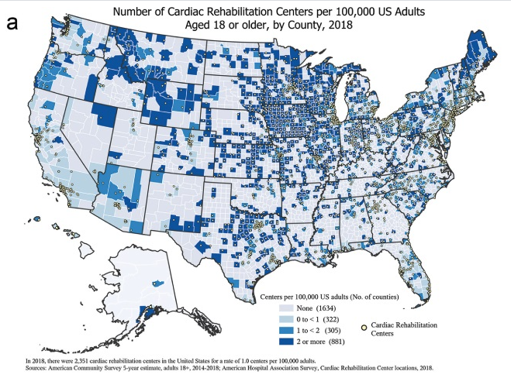
Number of Cardiac Rehabilitation Centers per 100,000 US Adults Aged 18 or older, by County, 2018
If every CR program in the US was filled to capacity, plus 10%, we could only serve ~45% of eligible patients.
Pack QR, et al. J Cardiopulm Rehabil Prev. 2014;34(5):318-26.
Wall HK, et al. J Cardiopulm Rehabil Prev. 2020;40(5):290-293.
Notes:
One reason for low participation in CR is an individual’s lack of physical access to a program or a program’s limited capacity to serve eligible patients due to lack of sufficient resources or staff.
This map depicts the number of cardiac rehabilitation centers per 100,000 adults by county in 2018. All of the grey counties do not have an established program. Note that you see even urban areas that lack facilities and/or sufficient capacity.
This analysis concluded that approximately 14% of adults lived in counties without a cardiac rehabilitation facility and 74% of adults lived in counties with less than 1 center per 100,000 adults.
Prior to the pandemic it was predicted that even if we every program was filled to 10% over their estimated capacity that only 45% of eligible patients could be served.
These data amplify the need for new models and investments to extend the reach and capacity of programs.

Slide 21
CR and the COVID-19 Pandemic
220 CR facilities closed between 2019 and 2021
CR participation declined after the onset of the pandemic with incomplete recovery
Varghese MS, et al. Circ Cardiovasc Qual Outcomes. 2022;15(12):e009618.
Notes:
The recent COVID-19 pandemic has further strained hospitals causing an estimated 200 programs to close and others to struggle to maintain sufficient staffing.
New care models are urgently needed to equitably increase CR participation
Available evidence suggests that patients participating in hybrid CR achieve similar outcomes compared with in-person CR.

Slide 22
Barriers to CR Referral
Lack of awareness
No clear, consistent signal to patients and families
CR program is not available or integrated into cardiovascular services and workflows
No automated electronic referral process
“Opt-out” hospital discharge orders
Studies have shown the strength of a physician’s endorsement can greatly influence patient enrollment in CR.
Ghisi GL, et al. Clin Cardiol. 2013;36(6):323-335.
Ades PA, et al. Mayo Clin Proc. 2017;92(2):234-242.
Notes:
Inadequate and/or inequitable referrals can be attributed to:
lack of awareness about the need for cardiac rehabilitation and its benefits for cardiac patients,
lack of clear and consistent signals to the patient and families about cardiac rehabilitation (especially signals coming from the prescribing physician),
lack of integration of cardiac rehabilitation in the delivery of cardiovascular care (for example, not having a cardiac rehabilitation liaison to speak with the patient about the service and facilitate enrollment), and/or
lack of automated electronic referral processes with “opt-out” hospital discharge orders to be sure no qualifying patient is withheld the opportunity to benefit from cardiac rehabilitation

Slide 23
Inadequate and Disparate CR Referrals
Referral to CR varies by:
Hospital
Sex of patient
Race/ethnicity of patient
Age of patient
Geographical location
Patient’s qualifying condition and/or procedure(s)
Implementing automatic CR referral strategies with care coordination can help 45% more patients enroll in CR.
Aragam KG, et al. J Am Coll Cardiol. 2015;65:2079–88.
Golwala H, et al. J Am Coll Cardiol. 2015;66:917–26.
Gomez Gonzalez L, et al. Front, Cardiovasc. Med. 2022;9:848610.
Li S, et al. J Am Heart Association. 2018;7:e008088.
Grace SL, et al. Arch Intern Med. 2011;171(3):235-241.
Notes:
CR referrals have been shown to vary by the treating hospital and by the patient, specifically the patient’s sex, race or ethnicity, geographical location, and the patient’s qualifying condition or procedure.
A study led by Aragam et al that used cardiac rehabilitation referral registry data discovered that it was the hospital that was the most important factor for predicting referral rates. Some hospitals referred 0% of its patients and others referred 100% of their patients.
Referral also varies by sex and race. Females are estimated to be 12% less likely to be referred compared to males and Hispanic and Asian patients are 36% and 50% less likely to receive a referral compared to white patients.
And, given the disparate geographical spread of programs, patients living in regions that lack programs are less likely to be referred.
Finally, the patient’s qualifying diagnosis or procedure can affect their likelihood of being referred. For examples, only 10% of patients with heart failure are referred to cardiac rehabilitation.
It is also important to stress that the referral, on its own, has little value unless it is followed with the physician’s endorsement of cardiac rehabilitation and sufficient care coordination services to facilitate enrollment.

Slide 24
Patient-Level Barriers to CR Participation
Patient-Level Barriers to attend 36 CR sessions:
Logistics of attending:
In-person (e.g., transportation, parking, available hours)
Virtually (e.g., internet connection, device access, available hours)
Cost-sharing
Competing responsibilities (e.g., work, childcare)
Cultural and language barriers
Ades PA, et al. Mayo Clin Proc. 2017;92(2):234-242.
Notes:
This leads to the final group of barriers to cardiac rehabilitation participation: the individual circumstances of the qualifying patient.
Unfortunately, adverse social determinants of health – like insufficient access to transportation, inadequate funds to pay accumulating co-payments, limited time off work or care-taking responsibilities, and cultural or linguistical barriers – restrict the likelihood of enrolling in or participating in cardiac rehabilitation.

Slide 25
What can be done?
Notes:
Next, we’ll explore the strategies and resources that can be applied by hospital care team members, quality improvement specialists, and public health professionals, who support these groups, to increase and improve uptake of cardiac rehabilitation.

Slide 26
New Paradigm to Optimize Use of Cardiac Rehabilitation
No CR
No CR
Hybrid CR
Hybrid CR
Traditional CR
Traditional CR
Old Paradigm
(current model)
New Paradigm
(new model)
Adapted from Olson, T. Balancing Technology with the Human Touch to Promote Exercise is Medicine. AACVPR 2018
Notes:
Million Hearts® and its partners support the new paradigm on the right to add
This new paradigm optimizes delivery of in-person cardiac rehabilitation and expands the reach by offering hybrid models that allow for cardiac rehabilitation to be provided both in person, often at the start or end of a program, and – for certain qualifying patients - outside the walls of the facility with the use of audio/visual communication technologies.
Hybrid cardiac rehabilitation programs have proven to delivery the
By leveraging the opportunity to provide non-center-based cardiac rehabilitation, access to cardiac rehabilitation, depicted in pink, is expanded to more eligible patients.

Slide 27
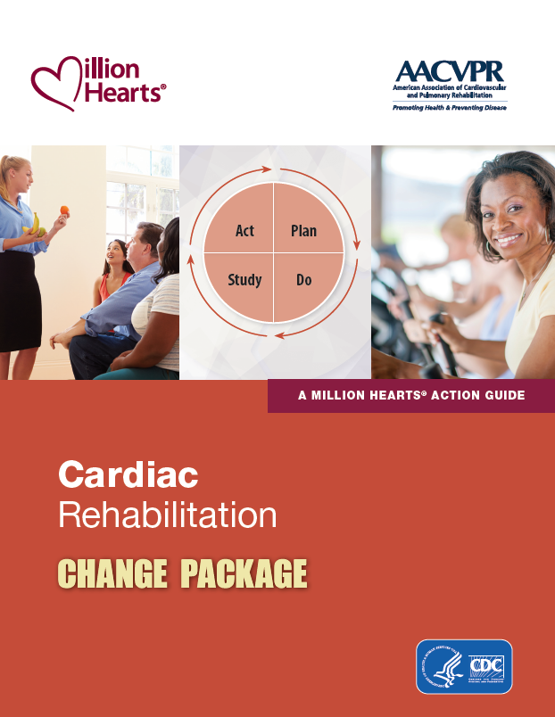
Million Hearts®/AACVPR Cardiac Rehabilitation Change Package, 2nd Edition
What: A quality improvement tool to increase CR use
What’s new (in 2023):
Making the business case for CR
CR program staffing models
More tools for implementing automatic referrals with care coordination (from AHRQ’s TAKEheart)
Strategies to build equity in CR enrollment
New tools for hybrid CR programs
And More!
https://millionhearts.hhs.gov/tools-protocols/action-guides/cardiac-change-package/index.html
Notes:
A first step is to increase CR participation delivered in-person and/or virtually is to explore strategies, tools, and resources within the second edition of the Million Hearts/AACVPR Cardiac Rehabilitation Change Package.
This tool was revised in 2023 to help quality improvement teams assess their quality improvement needs and select strategies from a listing of process improvements to optimize participation in cardiac rehabilitation.
The second edition of this tool includes change ideas and tools and resources to implement the ideas to help:
Make the business case for CR
Establish CR program staffing models
Implement automatic referral with care coordination processes
Strategies to build equity in CR enrollment
New tools for hybrid CR programs
And More!
The new version includes an estimated 250 evidence- and practice-based tools and resources that were gathered and vetted by a team of cardiac rehabilitation subject matter experts in collaboration with AACVPR.
You can access the change package using the URL on this slide.

Slide 28
Resources in the Million Hearts®/AACVPR Cardiac Rehabilitation Change Package, 2nd Edition
AACVPR “Turnkey” Strategies
Case studies
Program-specific tools
Hospital policies
Form templates
EHR screenshots
Organization-specific tools
(e.g., AHRQ, ACC, ACSM-CEPA, CDC)
AHRQ = Agency for Healthcare Research and Quality, ACC = American College of Cardiology, ACSM-CEPA = American College of Sports Medicine – Clinical Exercise Physiology Association, CDC = Centers for Disease Control and Prevention
Notes:
There are four types of tools showcased in the Change Package. These include:
AACVPR “Turnkey” Strategies – high-level issue summaries with concise guidance to aid implementation of programmatic strategies.
Case studies – detailed examinations of how a specific cardiac rehabilitation program was able to make a given change
Program-specific tools—tangible resources that have been implemented by programs or researchers and can be adopted as is or adapted to meet other programs’ needs. – the logos of some of the contributing institutions are provided on this slide.
Organization-specific tools —resources from clinical and public health organizations
These tools include fundamental resources developed by AACVPR and a new set of tools created by AHRQ as part of TAKEheart, an initiative to promote use of automatic referral with care coordination to increase enrollment in cardiac rehabilitation
You’re encouraged to review the change package with your quality improvement team to identify the strategies that make the most sense for your hospital or program.

Slide 29
Making the Business Case for Optimizing CR Participation
May improve patient experience, engagement, and retention
Decreases social isolation and loneliness
Shortens period of time to return to daily activities
Reduces hospital readmissions
Improves clinician or hospital performance on CR referral performance measures within cardiology/thoracic surgery registries
E.g., Cath-PCI, PINNACLE, Chest Pain-MI, Get With The Guidelines (GWTG) CAD, GWTG HF, and STS Adult Cardiac Surgery Database
Ensures the provision of comprehensive and clinical guideline-recommended cardiovascular care, of which may be recognized by quality improvement programs
Improves quality of care indicators (especially relevant for hospitals operating with a value-based payment model)
Hegewald J, et al. Cochrane Database Syst Rev. 2019;3:CD010748.
Long L, et al. Cochrane Database Syst Rev. 2019;1:CD003331.
Notes:
You may be thinking, “Great, but why should I or my organization implement the change package? What’s in it for me or us?”
While a new multi-center patient-centered outcomes research is currently underway, there is evidence that cardiac rehabilitation is valued by its participants. It, by definition, engages patients in their care and reduces social isolation and loneliness. The program has also proven to shorten the recovery time needed to return to work or other daily activities.
As mentioned previously, cardiac rehabilitation is proven to reduce hospital readmissions by up to 42%.
Steps taken to improve cardiac rehabilitation referrals will also improve your cardiac rehabilitation referral performance reported in 6 cardiovascular disease registries.
Optimal participation in cardiac rehabilitation also ensures your institution is providing comprehensive and clinical guideline-recommended treatment to your cardiac patients and may, therefore, qualify your institution to be national recognized for your commitment to providing optimal cardiovascular care.
Finally, cardiac rehabilitation can improve performance on a variety of quality of care indicators, many of which may be relevant if your institution participated in a value-based payment model.

Slide 30
Potential CR Partners By State, Territory, and/or Region
AACVPR State Affiliate Societies
Academic institutions
American College of Cardiology – State Chapter Leadership
Quality Innovation Network – Quality Improvement Organizations
State & Territorial Health Departments
State Hospital Associations
State Insurance Departments
State Medicaid Programs
State Rural Health Associations
State Vocational Rehabilitation Agencies
State health care insurance carriers
Other organizations or agencies unique to your state, territory, or region
Notes:
Million Hearts® is an initiative to increase cardiac rehabilitation participation nationwide. There are also a number of exciting developments happening at the state, territory, or regional level.
Here is a list of the different types of organizations or agencies that may be valuable partners to increase cardiac rehabilitation participation in your state or territory.

Slide 31
Actions for Hospitals as Employers
Analyze claims to find the % of eligible employees that receive CR and their “dose”
Educate employees about the benefits of CR and encourage CR-eligible employees to participate
Partner with the CR programs to best accommodate your employees’ needs
Eliminate or reduce cost-sharing with contracted health insurance carrier
CR shortens the time needed to return to work for people with coronary heart disease
Hegewald J, et al. Cochrane Database Syst Rev. 2019;3:CD010748.
Notes:
Beyond improving the care provided to patients, hospitals can leverage their influence as an employer in their communities to increase cardiac rehabilitation participation for their employees and their employee’s dependents.
Here are four ways that hospitals can assess and improve cardiac rehabilitation use in their communities as a prominent employer.
A 2019 Cochrane review of randomized control trials identified cardiac rehabilitation as an important intervention to shorten the time needed to return to work after a cardiac event and may increase the number of patients who return to work within the first 6 months after having a heart attack, bypass, or stent surgery.
Taking these or other approaches to optimize cardiac rehabilitation participation among hospital staff members may be an important strategy to improve employee satisfaction and maintain staffing.

Slide 32
Share What You’re Doing …And Be Recognized!
Share best practices and lessons learned. Email MillionHeartsCRC@cdc.gov.
Apply to be a Million Hearts® Hospital or Health System to be recognized for your work to prevent cardiovascular events
Join the Million Hearts® Cardiac Rehabilitation Collaborative (CRC) to contribute to the Million Hearts® 70% CR participation target.
Access new information and resources
Network with over 500 CR professionals
Learn from national and international subject matter experts
Identify new opportunities to engage
Notes:
Finally, please share your successes. Million Hearts® provides a platform to share best practices and recognize top performing institutions across the country.
You can send your best practices or lessons learned directly to Million Hearts at MillionHeartsCRC@cdc.gov.
You can also apply to be recognized as a Million Hearts Hospital or Health System for your work to increase cardiac rehabilitation participation and implement other Million Hearts® strategies to prevent cardiovascular events.
You’re also invited to join the Million Hearts® Cardiac Rehabilitation Collaborative or CRC, an open forum of multidisciplinary professionals taking steps to increase cardiac rehabilitation participation nationwide. This collaborative provides access to the latest information and resources, other cardiac rehabilitation programs, cardiac rehabilitation subject matter experts, and new opportunities for engagement.

Slide 33
Tools, Resources, References, and Key Publications
Go to the Million Hearts® Cardiac Rehabilitation webpage to access:
The Million Hearts®/AACVPR Cardiac Rehabilitation Change Package - 2nd edition (2023)
Million Hearts® Cardiac Rehabilitation Communication Toolkit
Million Hearts® Outpatient Cardiac Rehabilitation Use Surveillance Methodology (rev. 2023)
Million Hearts® Cardiac Rehabilitation Collaborative
And more!
This content is available for syndication for you to share on your website: https://tools.cdc.gov/medialibrary/index.aspx#/media/id/345335
Notes:
Please see the Million Hearts Cardiac Rehabilitation webpage on the Million Hearts website for more information and to access tools and resources for hospitals and health systems, clinicians, payors, and researchers and innovators.
You can also host this webpage content on your website by clicking on the bottom link. This link will take you to the CDC’s Public Health Media Library where you can get the code to easily embed the webpage content into your website.

Slide 34
Join Million Hearts®
Engage with Million Hearts® on social media
Facebook – Million Hearts® on Facebook
Twitter – @MillionHeartsUS
LinkedIn – Million Hearts® LinkedIn Showcase page
Subscribe to the Million Hearts® e-Update Newsletter (see bottom of the Million Hearts ® Website – https://millionhearts.hhs.gov/)
Contact us with your questions or comments
Email MillionHeartsCRC@cdc.gov
Notes:
You’re invited to join Million Hearts in support of the aim to prevent 1 million heart attacks and strokes in five years.
You can help spread the word on social media,
Subscribe to the Million Hearts® e-update to stay connected to the work of the initiative, or
contact Million Hearts® directly with your cardiac rehabilitation questions or comments.
Thank you for your time and attention.

Slide 35
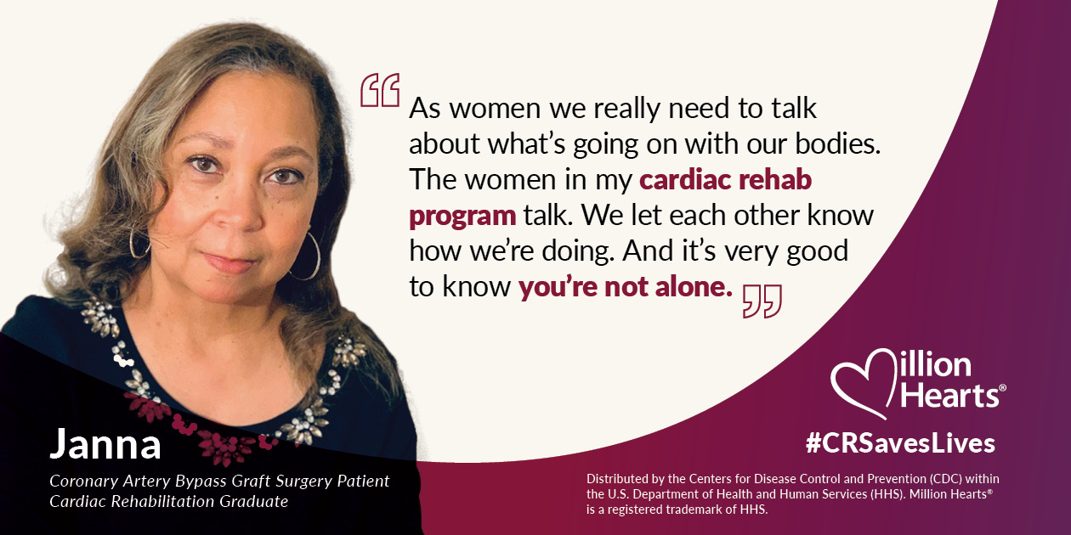
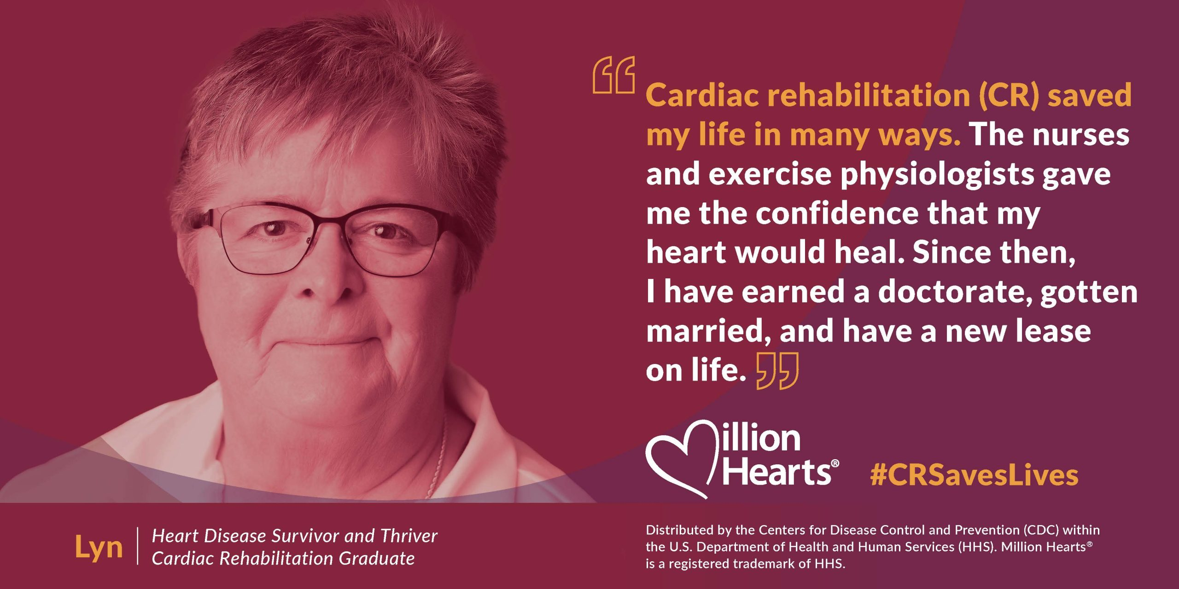
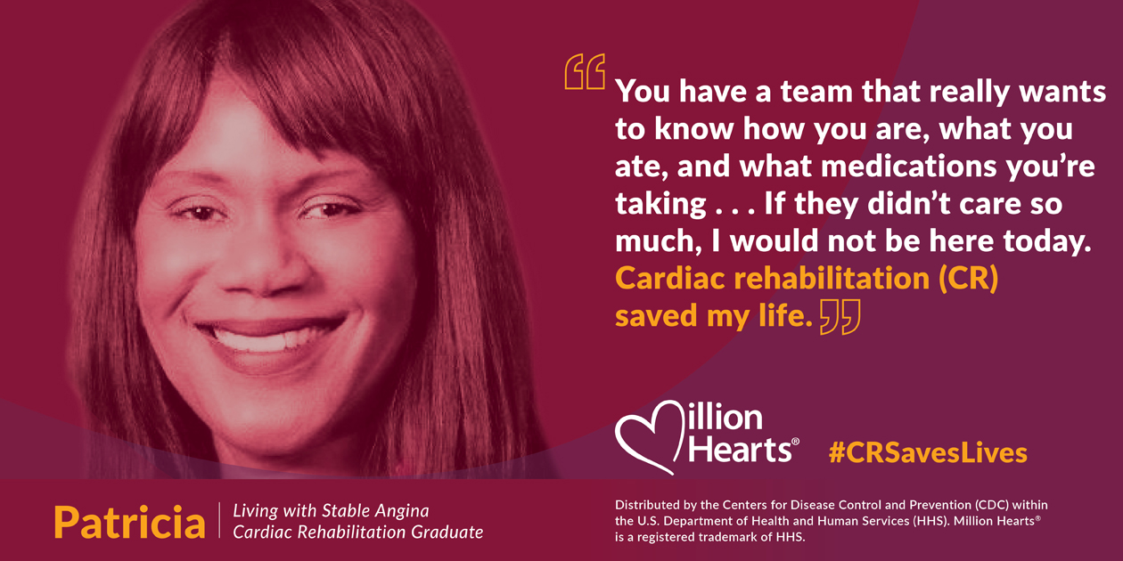
Testimonials from CR Participants
Notes:
To close, these are statements shared by four people who benefited from completing cardiac rehabilitation.

