Slide 1

Preventing 1 Million Heart Attacks and Strokes by 2027
Presenter’s Name
Title
Organization’s Name
Date
This presentation contains speaker’s notes.
Notes:
Beginning of Partner Slide Deck

Slide 2
Heart Disease and Stroke Burden
More than 1.6 million people in the U.S. suffer from heart attacks and strokes per year
More than 870,000 deaths per year from cardiovascular disease (CVD)
CVD is the greatest contributor to racial disparities in life expectancy
Uncontrolled hypertension is the primary contributor to the morbidity and mortality rate disparities in CVD between Black and White people.
Virani SS, et al. Heart disease and stroke statistics-2020 update: a report from the American Heart Association. Circulation. 2020;141(9):e139-596.2.
Centers for Disease Control and Prevention, National Center for Health Statistics. Underlying Cause of Death 1999–2017 on CDC WONDER Online Database website. http://wonder.cdc.gov/ucd-icd10.html. Accessed March 12 7, 2020.
Kochanek KD, Arias E, Anderson RN. How did cause of death contribute to racial differences in life expectancy in the United States in 2010? NCHS data brief, no 125. Hyattsville, MD: National Center for Health Statistics. 2013
Notes:
Each year, in the United States, 1.6 million people have a heart attack or stroke, and more than 870,000 adults die from cardiovascular disease.¹
Cardiovascular disease is the leading cause of potentially preventable death in the U.S.
The average direct and indirect cost of CVD and stroke in the United States is over $350 billion per year
Uncontrolled hypertension is the primary contributor to racial disparities in life expectancy among Black people

Slide 3
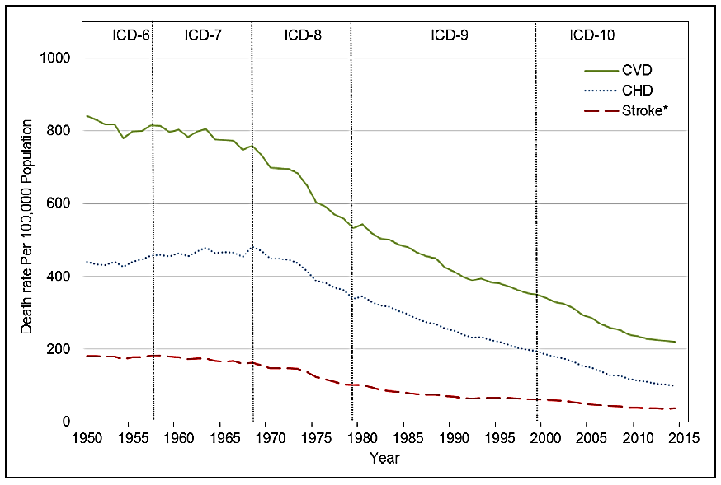
Heart Disease and Stroke Mortality Trends 1950-2015
Mensah GA, Wei GS, Sorlie PD, et al. Decline in Cardiovascular Mortality – Possible Causes and Implications. Circulation Research. 2017;120:366-380.
Notes:
Since the 70s, the mortality rates for CVD, CHD, and stroke have been on the decline. The flattening of the decline that we see here starting around 2010 is worrying and warrants attention on strategies to reverse this troubling trend.
CVD = cardiovascular disease, CHD = coronary heart disease (mostly heart attacks)

Slide 4
Missed Opportunities for Better Cardiovascular Health
4.1 M¹ not taking aspirin as recommended
67.8 M² with uncontrolled BP (≥ 130/80 mm Hg)
37.5 M³ not taking statins as recommended
52.5 M⁴ combustible tobacco users
+ 69.7 M⁵ who are physically inactive
~231.5 M missed opportunities
Wall HK, et al. Vital Signs: Prevalence of Key Cardiovascular Disease Risk Factors for Million Hearts 2022 — 2011–2016. MMWR. 2018;67(35):983-991.
Centers for Disease Control and Prevention (CDC). Hypertension Cascade: Hypertension Prevalence, Treatment and Control Estimates Among US Adults Aged 18 Years and Older Applying the Criteria From the American College of Cardiology and American Heart Association’s 2017 Hypertension Guideline—NHANES 2015–2018. Atlanta, GA: US Department of Health and Human Services; 2019. https://millionhearts.hhs.gov/data-reports/hypertension-prevalence.html. Accessed August 21, 2021.
Thompson-Paul AM, et al. Recommended and Observed Statin Use among U.S. Adults – National Health and Nutrition Examination Survey, 2011-2018. JACC. In submission.
Internal analysis of 2019 National Survey on Drug Use and Health data.
Preliminary results from internal analysis of 2020 National Health Interview Survey data.
Notes:
Why are we seeing these trends in mortality rates? We, as a nation, are missing many opportunities for improved cardiovascular health. Data on this slide are from a number of studies of the actions that could positively impact CVD, such as statin use and blood pressure control. When you calculate the deficits, so for example how many people have uncontrolled high blood pressure, you can see there are over 231 million missed opportunities for better management of CVD and its risk factors. Many of these opportunities are among people aged 35-64. This is our workforce. These are our caretakers. We need to do better.
CVD = cardiovascular disease

Slide 5
Million Hearts® 2027
Aim: Prevent 1 million—or more—heart attacks and strokes in the next 5 years by:
Promoting evidence-based strategies for cardiovascular disease prevention
Convening health care and public health champions
Facilitating meaningful collaboration and resource sharing
Addressing health equity through specific policies, processes, and practices
Notes:
To address this larger burden of disease and improve related risk factors, Million Hearts was launched. Million Hearts® is a national initiative that aims to prevent 1 million heart attacks, strokes, and other cardiovascular events* over the next 5 years.
This national initiative is co-led by the Centers for Disease Control and Prevention and the Centers for Medicare and Medicaid Services and is carried out by a variety of governmental and nongovernmental partners at local, state, and federal levels.
Million Hearts® provides a platform to shine light on a selection of evidence-based strategies for cardiovascular disease prevention, and the initiative serves as a learning lab and repository of tools, protocols, and resources for partners to use to implement these strategies. The only way we—as a nation—will meet this aim is through the collective and focused action of a variety of partners. In short, Million Hearts® provides the foundation and tools, and the Million Hearts® partners build the house.
*Within the Million Hearts® initiative, for plain language purposes, we often say “heart attacks and strokes,” but the definition of prevented cardiovascular events that we track is broader than that and includes deaths, hospitalizations, and emergency room visits from heart attack, stroke, transient ischemic attack, and heart failure, as well as other cardiovascular events.

Slide 6
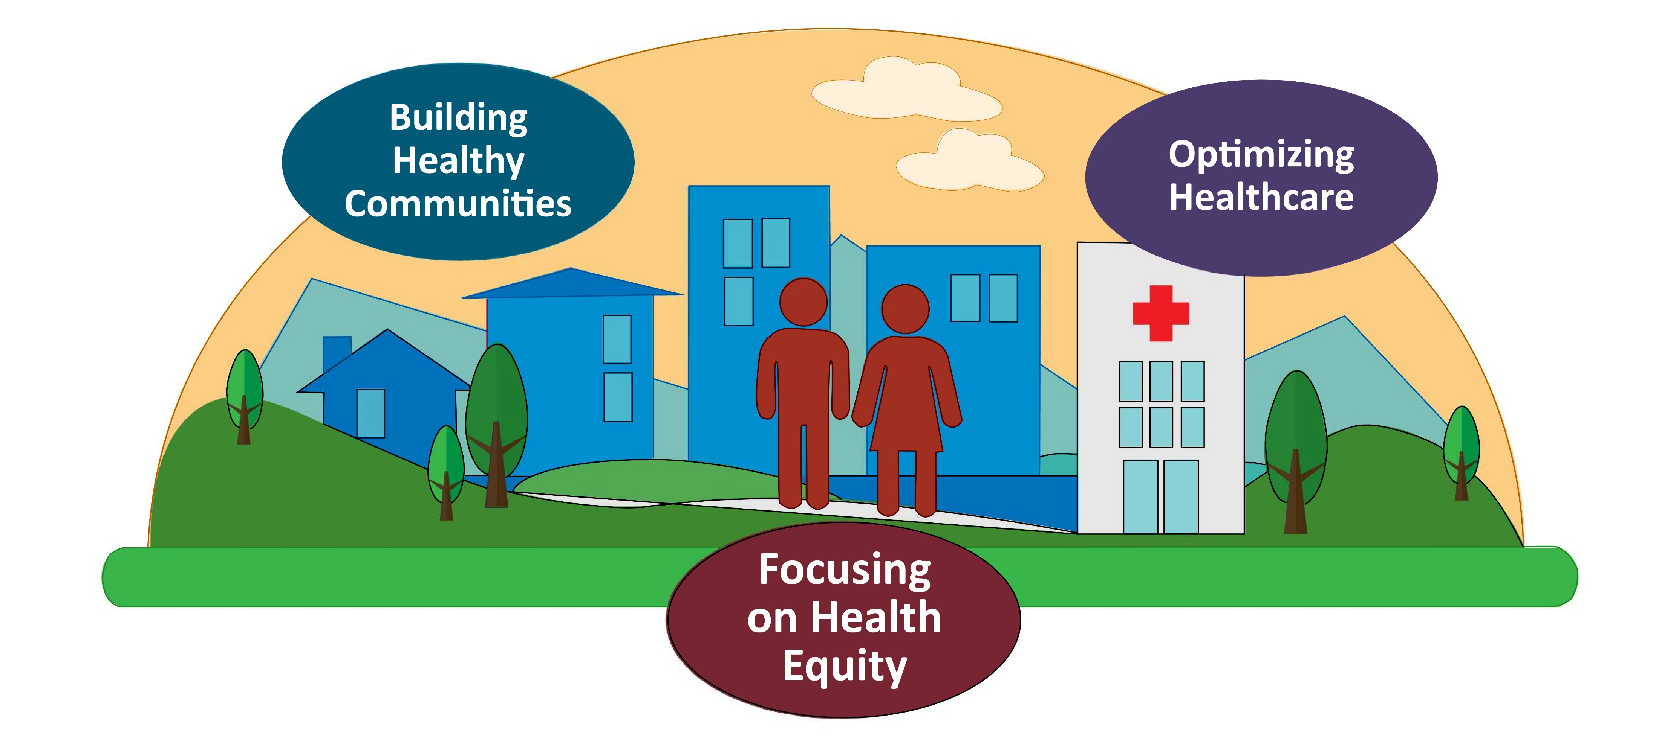
Million Hearts® 2027 Aim: Prevent 1 Million Heart Attacks and Strokes in 5 Years
Notes:
To meet the aim of preventing 1M heart attacks and strokes, Million Hearts is focusing on three priority areas:
Building Healthy Communities to make changes to the environments in which people live, learn, work, and play, so that the healthy choices are the easier choices for people to make.
Optimizing Care so that those with and at risk for cardiovascular disease receive the services and acquire the skills needed to reduce the likelihood of having a heart attack or stroke; and
Focusing on Health Equity for populations who suffer worse outcomes of cardiovascular disease and where there is evidence and the opportunity to make a significant impact.

Slide 7
Million Hearts® 2027 Priorities
Building Healthy Communities
Decrease Tobacco Use
Decrease Physical Inactivity
Decrease Particle Pollution Exposure
Optimizing Care
Improve Appropriate Aspirin or Anticoagulant Use
Improve Blood Pressure Control
Improve Cholesterol Management
Improve Smoking Cessation
Increase Use of Cardiac Rehabilitation
Focusing On Health Equity
Pregnant and Postpartum Women with Hypertension
People from Racial/Ethnic Minority Groups
People with Behavioral Health Issues Who Use Tobacco
People with Lower Incomes
People Who Live in Rural Areas or Other ‘Access Deserts’
Notes:
Bold and specific action is needed to reach set goals within each of these priority areas.
This slide summarizes the goals and priority populations within this three-pronged framework.
For those who are familiar with Million Hearts®, new priorities include decreasing particle pollution exposure and focusing on health equity to improve cardiovascular health outcomes among:
Pregnant and postpartum women with hypertension,
People from racial/ethnic minority groups,
People with behavioral health issues who use tobacco,
People with lower incomes, and
People who live in rural areas or other ‘access deserts.’

Slide 8
Building Healthy Communities
Goals | Evidence-based Strategies
Decrease Tobacco Use | Enact smoke-free space policies that include e-cigarettes Use point-of-sale and pricing approaches Conduct mass media campaigns
Decrease Physical Inactivity | Create or enhance access to places for physical activity Design communities and streets that support physical activity Develop and promote peer support programs
Decrease Particle Pollution Exposure | Raise awareness of the Air Quality Index Reduce wildfire smoke exposure Reduce traffic-related exposures like supporting idling policies Support power plant-, factory-related policies
Notes:
Preventing 1 million events is possible by achieving a 20% reduction in smoking, physical inactivity, and particle pollution exposure in our communities.
Smoke-free spaces and pricing approaches are effective in driving down tobacco use.
There is promising evidence that increasing access to places for physical activity, designing communities and streets with physical activity in mind, and peer support–type walking groups can help more individuals increase their physical activity level.
Breathing in particle pollution can cause serious problems, especially for those that have known heart problems. Increasing awareness of this risk, providing strategies to mitigate exposure, and reducing particle pollution overall are important strategies in the reduction of heart attacks and strokes.

Slide 9
Optimizing Care
Goals | Evidence-based Strategies
Improve Appropriate Aspirin or Anticoagulant Use | Support use of standardized approaches, teams, technology, data, patient supports
Improve Blood Pressure Control | Support use of standardized approaches, teams, technology, data, patient supports including DPP, SMBP, HIPS (strategies in the HCCP) Improve coverage for antihypertensives, SMBP devices
Improve Cholesterol Management | Support use of standardized approaches, teams, technology, data, patient supports including DPP, HIPS (strategies in the CMCP) Improve coverage for lipid-lowering agents
Improve Smoking Cessation | Support use of standardized approaches, teams, technology, data, patient supports, including HIPS (strategies in the TCCP) Improve barrier-free coverage for tobacco cessation
Increase Use of Cardiac Rehabilitation | Support use of automatic referral, care coordination, hybrid CR, program redesign (strategies in the CRCP) Improve coverage for cardiac rehabilitation
DPP = Diabetes Prevention Program, SMBP = self-measured blood pressure monitoring; HIPS = hiding in plain sight; HCCP = Hypertension Control Change Package; CMCP = Cholesterol Management Change Package; TCCP = Tobacco Cessation Change Package; CRCP = Cardiac Rehabilitation Change Package
Notes:
Likewise, in order to achieve excellence in clinical care, Million Hearts® 2027 partners are working to achieve 20% improvement on key clinical quality measures of cardiovascular care. These are the ABCS:
Aspirin use or other anticoagulants as appropriate,
Blood pressure control,
Cholesterol management, and
Smoking cessation.
While a nation-level improvement of 20% on the ABCS will help us achieve our goal of preventing 1M events, Million Hearts will continue to recognize and celebrate excellent performance of ≥80%.
Acknowledging the deeply rooted science in support of cardiac rehabilitation, the importance of the service in preventing cardiac events and improving health outcomes, AND the substantial room for improvement, with less than 30% of those eligible being referred and enrolled in a cardiac rehabilitation program, the goal for cardiac rehabilitation continues to be set at a participation rate of 70%.

Slide 10
Focusing on Health Equity
Notes:
Million Hearts® 2027 aims to advance health equity through specific policies, processes, and practices that provide fair access to resources and opportunities that enable cardiovascular health for all, with a deliberate emphasis on several populations

Slide 11
Pregnant and Postpartum Women with Hypertension
Cardiovascular conditions are a leading cause of pregnancy-related deaths¹ and are responsible for 1 in 3 pregnancy-related deaths²
Pregnancy-related deaths per 100,000 live births are significantly higher among
Women living in rural areas
Black and African American women, American Indian/Alaskan Native women³
Black women have higher rates of hypertensive disorders of pregnancy⁴
¹ Centers for Disease Control and Prevention (CDC). Pregnancy Mortality Surveillance System. Accessed January 20, 2022. https://www.cdc.gov/reproductivehealth/maternal-mortality/pregnancy-mortality-surveillance-system.htm
² Petersen EE, et al. MMWR Morb Mortal Wkly Rep 2019;68:423–429.
³ Merkt PT, et al. Am J Obstet Gynecol. 2021;225(2):183.e1-183.e16.
⁴ Bornstein E, et al. EClinicalMedicine. 2020;29-30:100657.²
Notes:
Cardiovascular conditions are a leading cause of pregnancy-related deaths and are responsible for 1 in 3 pregnancy-related deaths. Women living in rural areas, Black women, and American Indian/Alaskan Native women have significantly higher rates of pregnancy-related deaths. Black women and women over 40 have higher rates of hypertensive disorders of pregnancy (i.e., chronic hypertension, gestational hypertension, preeclampsia and eclampsia).

Slide 12

Focusing On Health Equity – Pregnant and Postpartum Women with Hypertension
Focusing on hypertensive disorders of pregnancy
Champion widespread SMBP use
Expand Medicaid coverage for SMBP devices, medications; extending coverage to 1-year postpartum
Support opportunities to close care gaps in transition of care between OB/GYN and primary care teams
Promote aspirin use to prevent preeclampsia
SMBP = self-measured blood pressure monitoring
Notes:
Strategies for pregnant and postpartum women will focus on preventing and managing hypertensive disorders of pregnancy. They include
Championing widespread SMBP use among pregnant and postpartum women
Expanding Medicaid to include coverage for SMBP devices, medications, and extending coverage to 1-year postpartum
Supporting opportunities to close care gaps when women transition from OB/GYN care to primary care
Promoting aspirin use to prevent preeclampsia

Slide 13
People from Racial and Ethnic Minority Groups
Non-Hispanic Black people have higher rates of HTN and develop HTN at younger ages than Non-Hispanic White people
Compared to non-Hispanic White people, non-Hispanic Black and Hispanic people have
Lower rates of blood pressure control
Lower rates of cholesterol management (statin use)
Lower rates of cardiac rehabilitation participation
Higher rates of physical inactivity
Higher rates of exposure to particle pollution
HTN = hypertension
Notes:
People from racial and ethnic minority groups experience a disproportionate burden of cardiovascular disease and associated risk factors.
Compared to white people, Black people have higher rates of hypertension and develop hypertension at younger ages.
Compared to white people, Black and Hispanic people have
Lower rates of blood pressure control, statin use, and rates of cardiac rehabilitation participation
Higher rates of physical inactivity and exposure to particle pollution

Slide 14

Focusing On Health Equity – People from Racial and Ethnic Minority Groups
Hypertension control in Black or African American persons
Implement MTM, SMBP, and other management in trusted spaces
Partner with barbershops, salons, faith-based organizations
Expand Medicaid coverage for SMBP devices, medications
Scale/spread tailored protocols to increase medication intensification; medication adherence strategies
Enhance sodium reduction efforts
Tobacco use
Support policies that prohibit the sale of flavored tobacco products, including menthol
Expand Medicaid coverage for barrier-free tobacco cessation interventions
MTM = medication therapy management
SMBP = self-measured blood pressure monitoring
Notes:
Strategies to address hypertension control in Black or African persons include
Implementing medication therapy management, SMBP, and other management in trusted spaces such as barbershops, salons, and faith-based organizations
Expanding Medicaid coverage for SMBP devices and medications
Scaling targeted protocols to increase medication intensification and medication adherence strategies
Providing enhanced sodium reduction education and resources
There is also a need to support policies that prohibit the sale of flavored tobacco products as people from racial and ethnic minority groups experience predatory tobacco marketing. Expanding Medicaid services can provide better access to barrier-free tobacco cessation interventions.

Slide 15
People with Behavioral Health Issues Who Use Tobacco
Behavioral health conditions, including Any Mental Illness (AMI) or Substance Use Disorders (SUD), are associated with increased tobacco use
The prevalence of tobacco use among adults with behavioral health conditions is double the prevalence of tobacco use among people without behavioral health conditions
UCSF Smoking Cessation Leadership Center. Smoking and Behavioral Health: 2019 NSDUH Trend Data Update. Accessed December 8, 2021. https://smokingcessationleadership.ucsf.edu/factsheets/smoking-and-behavioral-health-2019-nsduh-trend-data-update.
Notes:
People with behavioral health conditions, including mental health and substance use disorders, use tobacco at twice the rate as those without behavioral health conditions.

Slide 16

Focusing On Health Equity – People with Behavioral Health Issues Who Use Tobacco
Focusing on smoking cessation:
Support integration of tobacco cessation treatment into mental health and substance use care
Encourage smoke-free behavioral health facilities
Expand barrier-free Medicaid coverage for tobacco cessation services
Notes:
Strategies for people with behavioral health issues who use tobacco will focus on smoking cessation. They include
Supporting integration of tobacco cessation treatment into mental health and substance use care
Encouraging the implementation of smoke free policies in behavioral health facilities
Expanding Medicaid services to provide better access to barrier-free tobacco cessation services

Slide 17
People with Lower Incomes
Low socioeconomic status is associated with excess cardiovascular disease burden¹
Blood pressure control is lower among people with economic disadvantages including
Those with annual household incomes <$45,000
Those who do not have health insurance
Those with less than a high school degree²
¹ Commodore-Mensah Y, et al. Associations Between Social Determinants and Hypertension, Stage 2 Hypertension, and Controlled Blood Pressure Among Men and Women in the United States. Am J Hypertens. 2021;34(7):707-717.
² Muntner P, et al. Trends in Blood Pressure Control Among US Adults With Hypertension, 1999-2000 to 2017-2018. JAMA. 2020;324(12):1190-1200.
Notes:
Having a lower income or low socioeconomic status is associated with excess burden of cardiovascular disease. Uncontrolled hypertension is a primary contributor to cardiovascular disease morbidity and mortality. Blood pressure control is lower among those with annual household incomes less than $45,000, those who do not have health insurance, and those with less than a high school degree.

Slide 18

Focusing On Health Equity – People with Lower Incomes
Focusing on people with lower incomes:
Expand Medicaid coverage for SMBP devices, medications, cardiac rehabilitation
Support SMBP device loaner programs
Support inclusion of evidence-based strategies in value-based care delivery
Value-based insurance design
Value-based payment models (e.g., accountable care organizations)
SMBP = self-measured blood pressure monitoring
Notes:
Strategies to address cardiovascular health among people with lower incomes include
Expanding coverage for SMPB devices, medications, and cardiac rehabilitation
Supporting SMBP device loaner programs
Including evidence-based strategies in value-based care delivery such as value-based insurance design and value-based payment models

Slide 19
People who Live in Rural Areas and Other ‘Access Deserts’
Rural counties have fewer health care assets e.g., clinicians, specialists, emergency facilities, transportation options
Often long travel times to urgent and routine care and services
Many rural counties do not have access to cardiac rehabilitation centers; urban areas can also have cardiac rehabilitation ‘deserts’ when not enough facilities exist to serve the population
Notes:
Compared to people living in urban areas, people living in rural areas:
Are more likely to die prematurely from the leading causes of death including heart disease and stroke
Have fewer health care assets such as clinicians, specialists, emergency facilities, and transportation options
Are often required to travel long distances to urgent and routine care services
Are more likely to be uninsured, tend to be older, have lower incomes and less education
Many rural counties do not have ready access to cardiac rehabilitation centers. Urban areas can also have cardiac rehabilitation ‘deserts’ when not enough facilities exist to serve the population

Slide 20

Focusing On Health Equity – People who Live in Rural Areas and Other ‘Access Deserts’
Focusing on increasing access:
Support availability of robust virtual and remote models of cardiac rehabilitation
Support the use of SMBP and related telehealth
Support expanded scopes of practice for Nurse Practitioners, Physician Assistants, PharmDs, and Community Health Workers
SMBP = self-measured blood pressure monitoring
Notes:
Strategies focused on increasing access for people who live in rural areas and other ‘Access Deserts’ include
Supporting availability of robust virtual and remote models of cardiac rehabilitation
Supporting the use of SMBP and related telehealth
Supporting the expanded scopes of practice for nurse practitioners, physician assistants, PharmDs, and community health workers

Slide 21
Million Hearts® Resources and Tools
Quality Improvement Change Packages – hypertension control, tobacco cessation, cardiac rehabilitation
Action Guides – hypertension control; self-measured blood pressure monitoring (SMBP); tobacco cessation; medication adherence
Protocols – hypertension treatment; tobacco cessation; cholesterol management
Messages and Resources – undiagnosed hypertension, medication adherence, health IT, SMBP, particle pollution, physical activity, tobacco use, cholesterol management, blood pressure control, hypertensive disorders of pregnancy
Clinical Quality Measures – alignment
Consumer Resources and Tools
Notes:
Million Hearts® is helping partners take action to reach these goals by offering resources and tools.
These include:
Quality Improvement Change Packages on hypertension control, tobacco cessation, cardiac rehabilitation
Action Guides on hypertension control, self-measured blood pressure monitoring (SMBP), tobacco cessation, and medication adherence;
Protocols for hypertension treatment, tobacco cessation, and cholesterol management;
Messages and resources related to the problem of undiagnosed hypertension, medication adherence strategies, meaningful use of health information technology and SMBP, the link between particle pollution and heart disease and strategies to mitigate exposure to particulate matter, and strategies and resources to increase physical activity, reduce tobacco use, manage cholesterol, control blood pressure, and prevent hypertensive disorders of pregnancy
Million Hearts® also provides information on Clinical Quality Measures, including the description of measures and the country's performance on the measures via the clinical quality measures dashboard.
Finally, you can also find consumer resources and tools.
To learn more about the audience and purpose of each of these resources, please visit the Million Hearts® website at millionhearts.hhs.gov.

Slide 22
Our Commitment
[Insert partner statement of commitment]
[Insert description of intended actions]
Notes:
This slide is intended for you, the speaker/partner, to describe the commitment your organization is making. Million Hearts® provides the national platform, voice, and evidence-based strategies to prevent 1 million events. Our incredible partners are the key to implementing these strategies and moving the needle in cardiovascular disease prevention. Think about what you can do or implement within the scope of your work/organization to promote these strategies.
While connecting your activities to the Million Hearts® activities and communication efforts will help spread the word, we are also asking you to find the areas where your goals and the goals of the Million Hearts® initiative most align and to proclaim what your contribution will be and what strategies you will implement over the next 5 years to help prevent 1 million events.
For example: The Ohio State University is proud to partner with Million Hearts® and is leading the National Interprofessional Education and Practice Consortium to Advance Million Hearts®. Their goal is to educate health care students and health care professionals on the Million Hearts® initiative, increase screenings for hypertension, and improve population cardiovascular health. See https://millionhearts.osu.edu/ for more information.

Slide 23
Stay Connected
Million Hearts® e-Update Newsletter
Subscribe to receive the quarterly and ad hoc Million Hearts® e-Update newsletter
Million Hearts® on social media
Facebook – Million Hearts® on Facebook
Twitter – @MillionHeartsUS
LinkedIn – Million Hearts® LinkedIn Showcase page
Million Hearts ® Website – Million Hearts® (hhs.gov)
Notes:
Spread the word, share with your networks, and check out the resources and tools on the Million Hearts® website.

